Slide 1
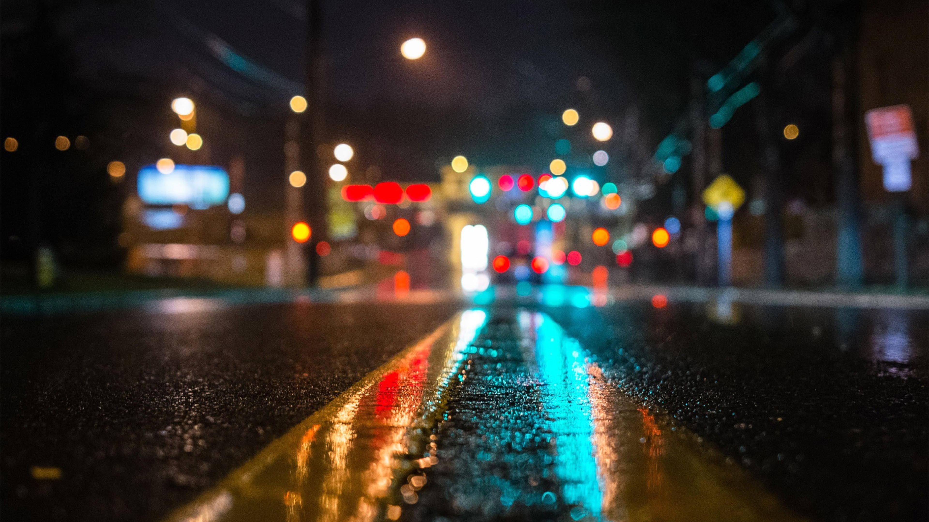
NATURAL VISION MOTOCYCLE

